Slide 1
Title: Data Preprocessing
Techniques and Best Practices

Slide 2
Introduction
Importance of Data Preprocessing
Ensures data quality and consistency
Enhances model accuracy and performance
Saves computational resources

Slide 3
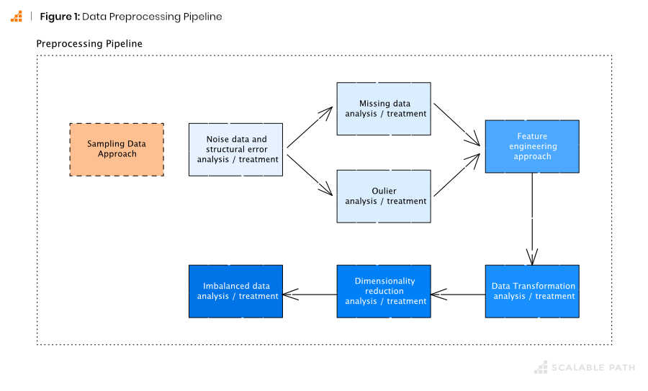

Slide 4
Understanding Data Preprocessing:
Definition and Purpose
Definition: Data preprocessing refers to the set of techniques used to clean and transform raw data before feeding it into a machine learning model.
Purpose: To improve the quality of data, making it suitable for modeling and analysis.
Impact on Model Performance
Examples: Poor quality data can lead to inaccurate models
while well-preprocessed data improves generalizability and model accuracy.

Slide 5
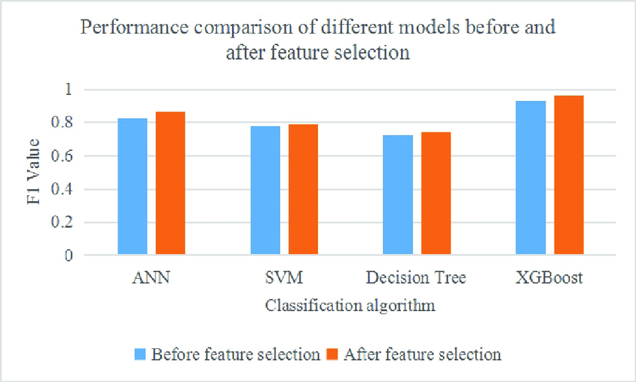

Slide 6
Steps in Data Preprocessing
Data Collection
Sources: Databases, APIs, Web scraping, Sensors
Ensuring data relevance and quality
Example: Collecting sales data from multiple stores.
Data Cleaning
Handling Missing Values
Removing Duplicates
Correcting Errors

Slide 7
Data Integration
Combining data from multiple sources
Example: Merging customer data from different departments.
Data Transformation
Normalization and Standardization
Encoding Categorical Data
Feature Scaling

Slide 8
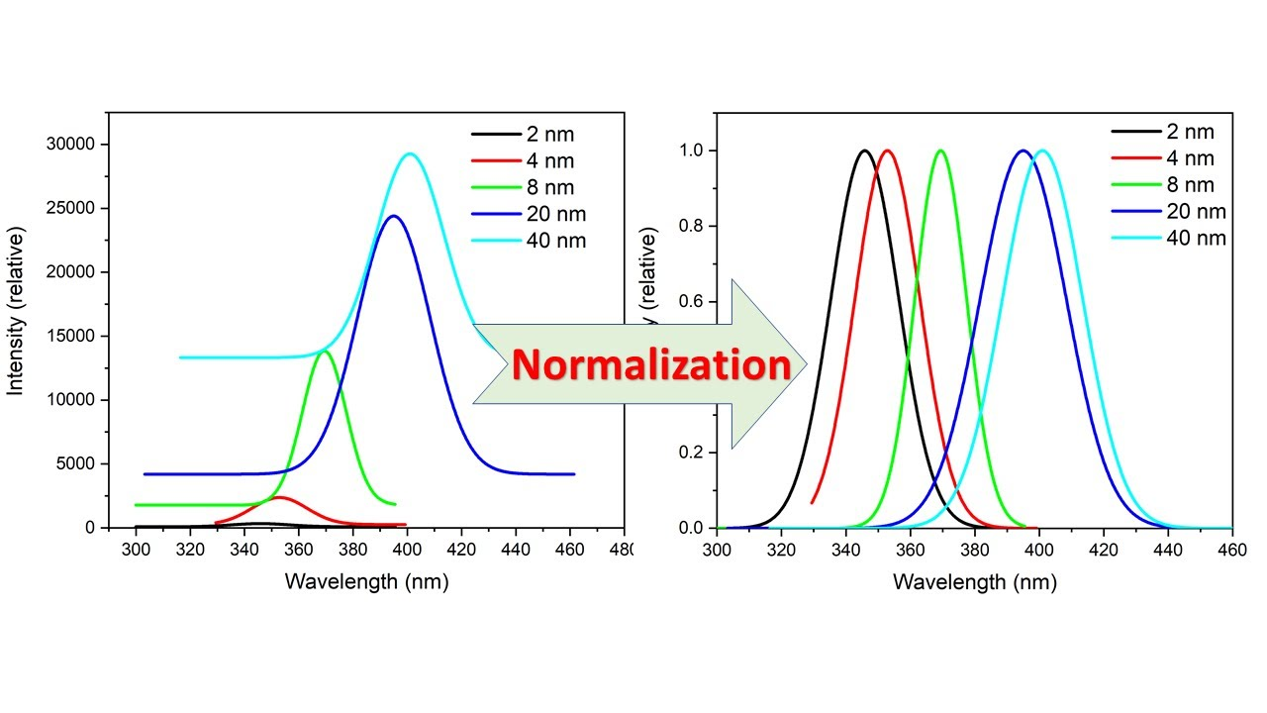

Slide 9
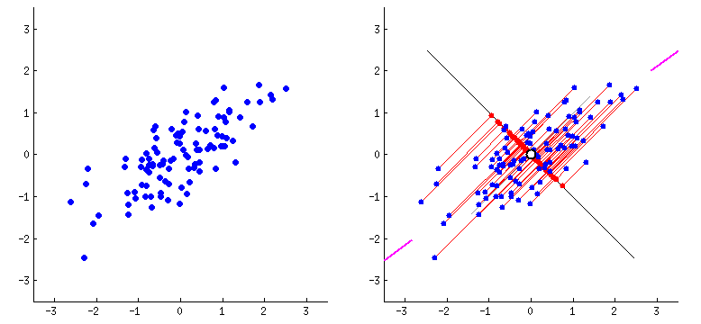
Data Reduction
Feature Selection
Dimensionality Reduction (PCA, LDA)
Example: Reducing features in a high-dimensional dataset.

Slide 10
Data Cleaning:
Handling Missing Data
Methods:
Deletion: Remove records with missing values.
Pros: Simple, quick.
Cons: Loss of information.
Imputation: Fill missing values using statistical methods (mean, median, mode).
Example: Filling missing ages with the mean age.
Prediction: Use algorithms to predict and fill missing values.
Example: Using regression to predict missing values.

Slide 11
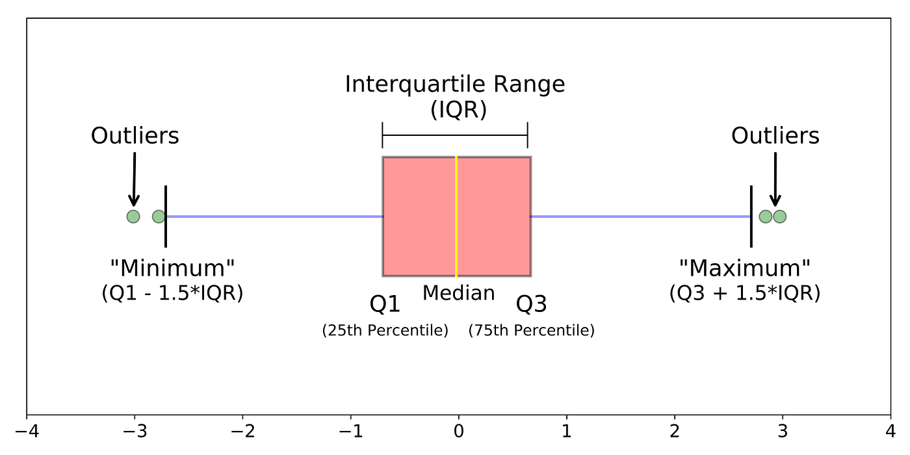
Outlier Treatment:
Detection Techniques:
Z-score: Identifies outliers based on standard deviations from the mean.
IQR (Interquartile Range): Identifies outliers based on the spread of the middle 50% of data.
Treatment:
Removal: Exclude outliers from the dataset.
Transformation: Apply mathematical transformations to reduce outlier impact.
Example: Removing or transforming salary outliers in employee data.

Slide 12
Data Transformation:
Normalization vs. Standardization
Normalization: Scaling data to a range of [0, 1].
Example: Normalizing feature values in a dataset.
Line graph can be used for showing normalized data.
Standardization: Scaling data to have a mean of 0 and standard deviation of 1.
Example: Standardizing test scores.
Histogram can be used for showing standardized data.
Encoding Categorical Variables:
One-Hot Encoding: Converts categorical variables into a series of binary columns.
Example: Encoding 'color' as 'red', 'blue', 'green’.
Label Encoding: Assigns a unique integer to each category.
Example: Encoding 'low', 'medium', 'high' as 1, 2, 3.

Slide 13
Feature Scaling:
Min-Max Scaling: Transforms features by scaling each feature to a given range.
Example: Scaling age values between 0 and 1.
Scatter plots can be used for showing scaled features.
Standard Scaling: Standardizes features by removing the mean and scaling to unit variance.
Example: Standard scaling of exam scores.
Scatter plot can be used for showing standardized features.

Slide 14
Data Integration and Reduction:
Combining Data from Different Sources
Methods:
SQL Joins: Inner join, outer join, left join, right join.
Merging DataFrames in Python: Using pd.merge().
Example: Merging sales data from different stores.
Dimensionality Reduction Techniques
Principal Component Analysis (PCA):
Reduces dimensionality by transforming features into a set of linearly uncorrelated components.
Example: Reducing features in image data.
Linear Discriminant Analysis (LDA):
Reduces dimensions while maintaining class separability.
Example: Reducing features in a classification problem.

Slide 15
Practical Examples
Example 1: Handling Missing Data
Description: Imputing missing values in a dataset.
from sklearn.impute import SimpleImputer
imputer = SimpleImputer(strategy='mean') data['Age'] = imputer.fit_transform(data[['Age']])
Example 2: Encoding Categorical Data
Description: Applying One-Hot Encoding and Label Encoding.
from sklearn.preprocessing import OneHotEncoder, LabelEncoder
# One-Hot Encoding ohe = OneHotEncoder() one_hot_encoded_data = ohe.fit_transform(data[['Color']])
# Label Encoding le = LabelEncoder() label_encoded_data = le.fit_transform(data['Size’])
Example 3: Normalizing Data
Description: Applying Min-Max Scaling.
from sklearn.preprocessing import MinMaxScaler
scaler = MinMaxScaler()
data['Age'] = scaler.fit_transform(data[['Age']])

Slide 16
Tools for Data Preprocessing:
Python Libraries
Pandas: Data manipulation and analysis.
Example: Cleaning and transforming data using Pandas.
NumPy: Numerical operations on arrays.
Example: Performing array operations.
Scikit-learn: Machine learning library with preprocessing utilities.
Example: Using Scikit-learn for scaling and encoding.
R Libraries
dplyr: Data manipulation.
Example: Using dplyr for data cleaning.
tidyr: Data tidying.
Example: Tidying data with tidyr.
caret: Streamlined model training process.
Example: Preprocessing data with caret.

